Slide 1
Software QA and Testing with Automation using Selenium WebDriver Course 1, Class 5 Deck 4 Register User
Instructor
David F Wagoner
PMP, CSQE, CMQ/OE
Copyright 2015 Montgomery College, David F Wagoner

Slide 2
Lab 3 - Register a User
Save your script to a new name and delete old content after line 10
Create code per following slides

Slide 3
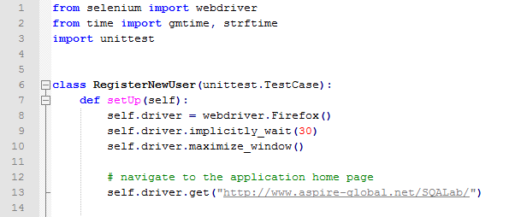
Lab Page 1 – Class & setUp

Slide 4
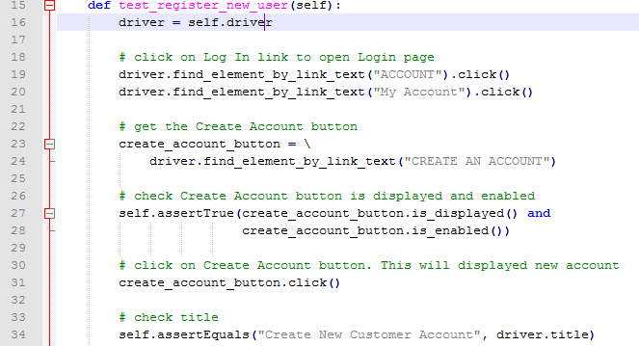
Lab Page 2 – Class & Main Method

Slide 5
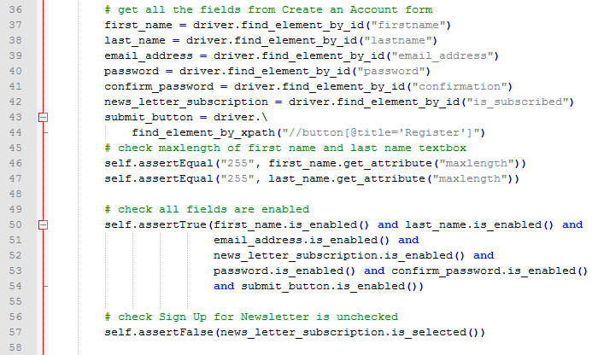
Lab 1– Get Field Ids

Slide 6
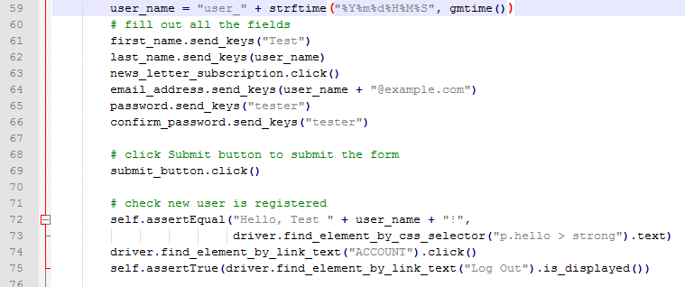
Lab Page 4 – Submit Fields

Slide 7
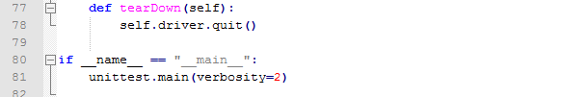
Lab Page 5 - tearDown

